Slide 1
Text-Mining: Advanced Options
The webinar will begin at 1 pm
You now have a menu in the top right corner of your screen.
The red button with a white arrow allows you to expand and contract the webinar menu, in which you can write questions/comments.
Feel free to type questions as we go, we will answer as many as we can at the end
We can’t hear you.
Notes:
Hello everyone.
The webinar starts in 5 minutes.
Hopefully you can all hear me –you are on mute and will stay on mute throughout.
If you want to ask a question you can do so at any time by typing into the questions box at the top right of your screen – press the red arrow if you can’t see it.

Slide 2
Can you hear us?
?
Notes:
You should see a poll on your screen around about now. And if you can answer whether you can hear us or not…
Yes
No

Slide 3
Can you hear us?
If not:
Check your speaker/headset is plugged in / volume is on.
Click on audio to change to listening via phone
We are recording this webinar and will post it on YouTube (https://www.youtube.com/user/UKDATASERVICE)
Notes:
You should see a poll on your screen around about now. And if you can answer whether you can hear us or not…
Yes
No

Slide 4


Text-Mining: Advanced Options
Dr. J. Kasmire
Research Fellow at Cathie Marsh Institute and UK Data Service
julia.kasmire@manchester.ac.uk
@JKasmireComplex
Notes:
Hello! My name is Dr. Julia Kasmire and my role is to teach computational social science within the New Forms of Data Training team on behalf of the UK Data services. Today I will be talking about Text-mining, specifically on a few of the more advanced options that you might want to do with the text-mining and natural language processing skills you have developed.

Slide 5
You might also be interested in...
Recent -
Being a Computational Social Scientist
Text-mining – Intro and Theory, Basic Processes
Web-scraping for Social Science Research (case study, from websites, and from API's)
Code Demos
https://www.ukdataservice.ac.uk/news-and-events/events/past-events.aspx
https://www.youtube.com/user/UKDATASERVICE
Upcoming -
Health Studies User Conference 30 June 20
Social Data and the Third Sector 2 to 16 July 20
Text-mining Code Demos – expected in September
Notes:
As per usual, I want to highlight a few resources and events that you may find interesting.
Recent trainings include a session on Being a computational social scientist, the first two text-mining webinars in a series of three, a series of webinars on web-scraping for social science research, and some code demos, mostly focussed on web-scraping and being a computational social scientist.
You can find the slide decks and recordings of these recent training events on the UKDS website, under the past events link on the events and news tab. The recordings from these previous events are also on the UKDS youtube channel.
You may also be interested in some of our upcoming events, including
Our annual health studies user conference, which is tomorrow.
There is also a multi-day event on social data and the third sector in July. And I hope to run some code demos on the text-mining skills covered in this series. These are currently planned for September although the exact dates have not been fixed yet.

Slide 6
Text-mining has 4 basic steps
Retrieval
Processing
Extraction
Analysis
Processes:
Tokenisation, standardisation, removing irrelevancies, linguistic form consolidation
Basic NLP:
Tagging, Chunking, etc.
Basic Extraction:
Frequency counts, similarity, discovery
Advanced Extraction:
Classification tasks
Sentiment analysis
Extracted named entities
Network graphs
Notes:
If you attended either of the previous two webinars in this text-mining series, you might remember that text-mining has four basic steps
CLICK
retrieval, processing, extraction and analysis. Today, we are focussing on
CLICK
extraction, specifically more advanced options than those that you saw last time.
CLICK
Specifically, today will cover classification tasks, including sentiment analysis, and entity extraction, especially as it relates to creating social networks and network graphs.

Slide 7
Automatic classification – a thought experiment
100,000 old scientific articles to be sorted into which modern scientific field they match best
No keywords, not published in journals or published in journals that don’t match current fields, use old terminology, etc.
Rather than read and manually classify them all, how about we teach a computer to classify them for us
Notes:
We all understand the concept of sorting things into categories. We have been doing it for most of our lives. But imagine if the things we wanted to sort were really difficult.
CLICK
Like 100,000 old scientific articles that we wanted to sort into modern scientific fields or disciplines to get a better sense of the development of those fields.
CLICK
Depending on the age of those articles, they may not have keywords or abstracts, may not have been published in journals or at least not in journals that we understand as relating directly to modern fields, may not use terminology that we understand well, may not have used titles in the way that we do now, etc. etc.
Basically, all the easy ways that we would think to sort them quickly may not be available to us.
We certainly don’t want to read 100,000 old articles ourselves. Especially since multiple people would need to read them all so we can get subjectivity measures.
CLICK
Instead, we can ask a computer to do it for us or, more accurately, to create a probability measure of which category each article might belong to. We can then go over and review a percentage of cases to see how much we agree with the computer’s judgements. We can also review the borderline cases to apply critical thinking.
But how do we get a computer to do that?

Slide 8




Classification tasks require:
A set of documents
A set of classes to which the documents may belong.
A tool that makes predictions about what classes the documents belong to
Notes:
To do that you need
CLICK
A set of documents, like our 100,000 old articles. You also need
CLICK
A set of categories into which the documents may belong. In this thought experiment, it would probably be a list of the modern scientific disciplines we want to match up the old articles to. This could be a simple list or it could be a hierarchical list.
Finally, you need
CLICK
A tool to do the classifying, which would probably be based on machine learning.

Slide 9


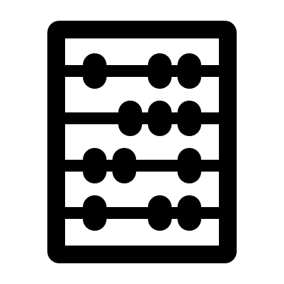


Classification returns:
A prediction about what class a new document belongs to
A number between 0 and 1 for each class
= 0.54 0.25 0.05 0.0001
= 0.71 0.37 0.12 0.09
= 0.92 0.58 0.01 0.001
Notes:
What it actually returns is a
CLICK
prediction of belonging, which is typically a number between zero (definitely does not belong) and 1 (absolutely belongs) for each class.
For our scientific article example,
CLICK
This might look like a .54 probability that this document is a physics article, a .25 probability that it is a math article, a .05 probability that it is a biology articles and a .0001 probability that it a bananas article. I just liked the banana as an icon.
Now, the tool would return different probabilities for different articles, so that
CLICK
This article is very likely to be a biology article, might also be a bananas article, probably not physics or math while
CLICK
Another article is almost certainly bananas, could be biology very unlikely to be physics or math.
But how does the tool actually make these predictions?
Well…

Slide 10


Machine learning
A training set of documents that are already correctly classified.
Train a model or learning algorithm on the training set.
A test set of documents that are already correctly classified.
Test the model, comparing performance to a benchmark if possible.
Notes:
Classification probabilities depend on teaching a machine what is associated with each class. This is achieved by taking a
CLICK
training set of documents that is correctly (and probably manually) classified and using it to train a
CLICK
Learning algorithm, which does a fancy-pants version of word-frequency counts to find the most common words or combination of words that are associated with each category.
For example, words like ‘quantum’ or ‘boson’ or ‘quark’ probably only occurs in physics articles, so if a document has one or more of those words, it is very probably a physics paper. Likewise, biology articles have their own words or phrases that are more or less unique to biology, and maths has its own, etc. etc.
Then, you need to test your algorithm
CLICK
On a test set of documents, also correctly classified, that the learning algorithm has not yet seen.
CLICK
Your learning algorithm should do as well or better than a benchmark, which might just be people or it might be previous learning algorithms.
Performance has a few components, and you may want to only focus on improving on one of them.
Accuracy refers to how many predictions our model makes that are completely correct.
Precision describes the ratio of true positives to true positives plus false positives in our predictions.
Recall describes the ratio of true positives to true positives plus false negatives in our predictions.

Slide 11


Sentiment analysis
Training & test sets = csv/data frame/etc. with text documents and ‘pos’ or ‘neg’S tags
Learning algorithm = spaCy/nltk/other nlp option
Benchmark not always relevant, performance metrics still are
Notes:
Sentiment analysis is a classification task. Instead of classes like ‘physics’ or ‘maths’ or ‘biology’, there would be classes like ‘positive’ and ‘negative’ or sometimes also ‘neutral’.
There are training and test sets
CLICK
already available, if you want to use them but you can make your own training and test sets too.
There are also
CLICK
Tools and pre-trained models available, if you want to do basic sentiment analysis. But, if you want to do something new or specific, you may need to train your own classifier on your own training data.
CLICK
If you are doing an entirely novel task or using entirely novel training sets, benchmarks may not be available or relevant. Performance metrics still are and you have to be clear about how your model scores on the different metrics, which ones you are trying to optimise, etc.
You optimise them by updating your classifier with new training data. You need to be clear about why you update it, what data you use to update it, what effect that has on the performance, etc.
Let’s take a closer look at how sentiment analysis and model training works.

Slide 12
Sample training and test data
train = [
('I love this sandwich.', 'pos'),
('this is an amazing place!', 'pos'),
('I feel very good about these beers.', 'pos'),
('this is my best work.', 'pos'),
("what an awesome view", 'pos'),
('I do not like this restaurant', 'neg'),
('I am tired of this stuff.', 'neg'),
("I can't deal with this", 'neg'),
('he is my sworn enemy!', 'neg'),
('my boss is horrible.', 'neg')]
test = [
('the beer was good.', 'pos'),
('I do not enjoy my job', 'neg'),
("I ain't feeling dandy today.", 'neg'),
("I feel amazing!", 'pos'),
('Gary is a friend of mine.', 'pos'),
("I can't believe I'm doing this.", 'neg')]
Training = associates features (words) to scores (word1 = ‘pos’, word2 = ‘pos’, wordn = ‘neg’)
Test = sums feature associations to get probable score (‘pos’ + ‘neg’ + ‘pos’ = ‘pos’)
Notes:
Imagine that we have a prepared training set and that it looks like
CLICK
This. Each item in this set is a string and each item has a class, either ‘pos’ or ‘neg’.
Similarly, we have a prepared test set and it looks like
CLICK
This. It is more or less the same as our training set, but shares no documents in common. Although we have prepared training and test data sets, let’s imagine that we need to train our own classifier, which is likely to be a naïve bayes classification tool (there are other options).
CLICK
These take the training data that you pass to them, extract features from the string and associate those features with being either ‘pos’ or‘neg’.
Then, for testing, the trained classifier sums up the features and finds, on balance, whether the test sentence is likely to be ‘pos’ or ‘neg’.
This is a bit like trying to reverse engineer a marking criteria based on marked exam papers, and then applying your reverse engineered criteria to unmarked papers.
The accuracy, both for the sentiment analyser or for a reverse engineered marking criteria, would be to compare the decisions made in the test set to the scores assigned in the test data or the marks given by the real marking criteria.

Slide 13
Naïve Bayes Classification – basic frequency in action
Training = 'I' 'love' 'this' 'sandwich' (pos) plus 'I' "can't" 'deal' 'with' 'this' (neg)
'love' 'sandwich' "can't" 'deal' 'with’
'I' 'this' 'I' 'this’
Test = ‘I deal with sandwiches’ (neg)
'I deal with sandwiches’
Prediction = ‘neg’ Actual = ‘neg’
Prediction strength = –0.25.
There are more sophisticated options if you want a custom naïve bayes classifier.
Notes:
Let’s look at an example.
CLICK
Imagine my entire training data set was these two sentences, one positive and one negative. Each sentence has some unique words and some shared words. The extracted features
CLICK
would be that love and sandwich are positive while can’t, deal and with are negative. I and this are neutral as they both appear in both sentences.
CLICK
If our test sentence is ‘I deal with sandwiches’ the sentiment analyser would find
CLICK
one neutral word, two negative words and one positive word. It would probably return a prediction of
CLICK
‘neg’, but which numerically might be a -0.25. “I deal with sandwiches” isn’t strongly negative, but it is more negative than it is positive because “deal with” implies hassle or bother. As the prediction matched the real class assigned to the sentence, our accuracy rating would be good.
CLICK
You can specify more sophisticated classifiers. They can look at co-occurrence, semantic roles, keywords, and more rather than simple frequency, or they can give more weight to first or last words. There are a lot of options that might be more or less suitable, depending on the research question and data set.

Slide 14


Efficiency
Real training and test data sets are huge.
Processing will reduce the number of (irrelevant) features to be extracted/evaluated.
love, loves, loving …
deal, deals, dealing …
love
deal
Notes:
The sentiment analysis training and test data sets I showed you here are TRIVIALLY small.
CLICK
Real ones have tens of thousands, hundreds of thousands, or even millions of items.
Training a classifier on a very big data set means associating the score with EVERY FEATURE in the training set, which can be VERY computationally intensive. Many of those features won’t be relevant, so if resources are tight…
CLICK
You should process your training data to reduce the number of, hopefully irrelevant, features like punctuation, stop words, different forms of the ‘same words’ etc.
Your computer will be much less happy trying to extract the features for unprocessed text
CLICK
That it would be trying to extract the features for processed text
CLICK
So, unless your research really needs extracted features for different word forms, do the processing!

Slide 15

Network graphs
Map relationships between things
The things are ‘nodes’
The relationships are links or ‘edges’
Notes:
Now, on to extracted entities and network graphs.
CLICK
Network graphs are like a map of the relationships between things.
CLICK
The things, known as nodes, can represent just about anything – people, businesses, cities, social movements, rock bands, whatever.
CLICK
The relationships between those things are links, usually called edges in network graph terminology, and can represent just about any kind of relationship – social, financial, influential, oppositional, whatever.

Slide 16


Network graphs can be…
Undirected, meaning the edges are bi-directional
… or directionless
Notes:
There are various main features that a network can have or not have. For example,
CLICK
an ‘undirected’ network graph has edges that are bi-directional, which is pretty much the same as having edges that are
CLICK
Directionless.
Undirected graphs are meant to represent relationships that are reciprocal or that have no clear difference between object or subject. For example, if Noah and Sherry here work together, then Noah has a colleague relationship with Sherry and Sherry has a colleague relationship with Noah.

Slide 17
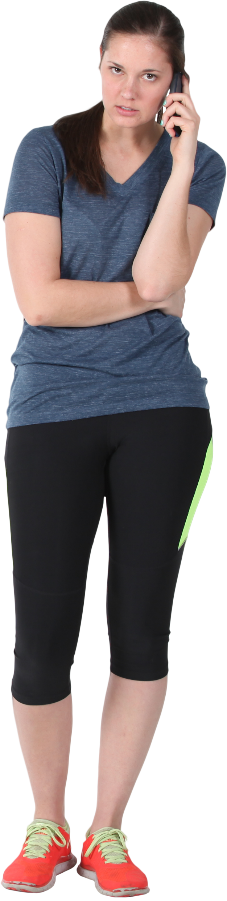



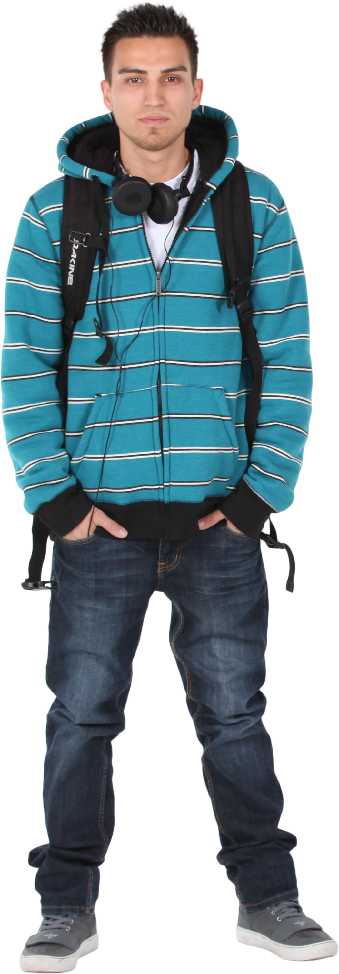
Network graph can be…
Directed,
meaning the edges are
uni-directional
Indicates non-reciprocal
relationships
Although nodes can by
multiply linked to show
reciprocal but unequal
relationships
Notes:
Alternatively, network graphs can be
CLICK
directed, meaning that the edges go from one node to the other. These kinds of network graphs are used to map
CLICK
non-reciprocal relationships
CLICK
Although you can have a second set of edges that go the other way to show a reciprocal but unequal relationship.
For example, here we see the woman in the center is a doctor. You can tell because she has a stethoscope. She is connected to all of the other people because they are patients registered with her, so the edges connecting her to them represent responsibility. All of those patients also have a relationship with her, and so they are connected by edges too. But they do not have the same relationship with her that she has with them because they rely on her rather while she is responsible for them.

Slide 18

Network graphs can be…
Unweighted, meaning the edges
are all equal “weight”
Indicating all relationships are
Of equal ‘strength’, ‘value’,
etc.
Notes:
Now, network graphs can also be
CLICK
Unweighted, meaning that all of the edges are drawn the same way and are seen as equivalent .
CLICK
This indicates that their relationships are of equal strength, or value, or age, or whatever.
So, in this example, we see Sherry and Noah again, but also another colleague Marisol. These unweighted edges indicated that they are all equally likely to work with each other or that they otherwise have the ‘same’ depth of relationship.

Slide 19
Network graphs can be…
Weighted, meaning the edges
have individual “weight”
Indicating relationships vary
in ‘strength’, ‘value’, etc.
Notes:
In contrast, a network graph that is
CLICK
Weighted has edges of varying weight, indicating
CLICK
That the relationships do not have all the same strength, value, age, etc.
Returning to our colleague example, this time, we see that Sherry and Marisol have a bolder, bluer edge between them. This could mean that they work on the same project together relatively often, perhaps 3 days out of a given week. In contrast, the medium colour and size edge between Sherry and Noah suggests they work together less often, maybe only one or two days per week. Meanwhile, the relatively pale and small link between Noah and Marisol suggests that they work together the least often, maybe only every other week.
Alright, so that wraps up some ideas from network graph theory, but how do we use these ideas in combination with text-mining?

Slide 20
Nodes – basic processes
['Archibald walked
through Manchester
with Beryl.’]
['Tariq saw Beryl
when she was
playing tennis.’,]
['Archibald shares a
house with Beryl
and Cerys.’]
[('Archibald', 'NNP'), ('walked', 'VBD’),
('through', 'IN'), ('Manchester', 'NNP’),
('with', 'IN'), ('Beryl', 'NNP’)('.', '.’)]
[('Tariq', 'NNP'), ('saw', 'VBD'), ('Beryl', 'NNP'), ('when', 'WRB'), ('she', 'PRP'), ('was', 'VBD'), ('playing', 'VBG'), ('tennis', 'NN'), ('.', '.’)]
[('Archibald', 'NNP')), ('shares', 'NNS'), ('a', 'DT'), ('house', 'NN'), ('with', 'IN'), ('Beryl', 'NNP'), ('and', 'CC'), ('Cerys', 'NNP’) , ('.', '.’)]
Notes:
The process is fairly logical, but starts with basic processing. In this case, we turn a few sample sentences
CLICK
And run them through basic word-tokenisation and part-of-speech tagging processes
CLICK
To get output like this. You could also do any other processes you needed to do, like spell checking, standardising on one format with RegEx, etc.

Slide 21
Nodes – basic processes → Named Entity Recognition chunker
['Archibald walked
through Manchester
with Beryl.’]
['Tariq saw Beryl
when she was
playing tennis.’,]
['Archibald shares a
house with Beryl
and Cerys.’]
[Tree('S’,
[Tree('PERSON', [('Archibald', 'NNP')]), 'walked', 'VBD'), ('through', 'IN'), ('Manchester', 'NNP'), ('with', 'IN’),
Tree('PERSON', [('Beryl', 'NNP')]), ('.', '.’)])
Tree('S’,
[Tree('PERSON', [('Tariq', 'NNP')]), ('saw', 'VBD'), Tree('PERSON', [('Beryl', 'NNP')]), ('when', 'WRB'), ('she', 'PRP'), ('was', 'VBD'), ('playing', 'VBG'), ('tennis', 'NN'), ('.', '.')])
Tree('S’,
[Tree('PERSON', [('Archibald', 'NNP')]), ('shares', 'NNS'), ('a', 'DT'), ('house', 'NN'), ('with', 'IN’),
Tree('PERSON', [('Beryl', 'NNP')]), ('and', 'CC'), Tree('PERSON', [('Cerys', 'NNP')]), ('.', '.')])
Notes:
Then, you would run a Named Entity Recognition chunker, which
CLICK
Returns data like this, with sentence and named entities tagged as ‘trees’, ideally, this would correctly label all the people as people, the places as places, etc. but there is no guarantee. Named Entity recognition chunkers are a kind of classifier, and if you are getting poor results, perhaps because you have non-standard names or something like that, you may need to train your own classifier.
I have kept the original sentences here, for clarity, because the next step is …

Slide 22




Nodes – basics → NE chunker → Extract chunks
['Archibald walked
through Manchester
with Beryl.’]
['Tariq saw Beryl
when she was
playing tennis.’,]
['Archibald shares a
house with Beryl
and Cerys.’]
['Archibald', 'Beryl']
['Tariq','Beryl']
['Archibald', 'Beryl', 'Cerys']
Notes:
To extract all the chunks that we want.
CLICK
If the trees were well done, then you can search for all trees with label = PERSON, but we could also search for all tokens with POS-tag = proper noun, or something like that.
Depending on your research question, you might want named entities that are places, organisations, etc. Or maybe you want dates, legal cases, newspaper headlines, whatever is relevant for you.
Then…

Slide 23
Nodes – basics → NE chunk → Extract chunks → find unique chunks
['Archibald walked
through Manchester
with Beryl.’]
['Tariq saw Beryl
when she was
playing tennis.’,]
['Archibald shares a
house with Beryl
and Cerys.’]
['Archibald’,
'Beryl’
'Tariq’,
'Cerys']
Notes:
Then, you want to remove duplicates to get a
CLICK
list of all the unique named entities that you have extracted. These will become the nodes in your network graph.

Slide 24
Edges – basics → NE chunk → Extract chunks
['Archibald walked
through Manchester
with Beryl.’]
['Tariq saw Beryl
when she was
playing tennis.’,]
['Archibald shares a
house with Beryl
and Cerys.’]
['Archibald', 'Beryl’]
['Tariq','Beryl’]
['Archibald', 'Beryl', 'Cerys']
Notes:
We also need to extract the edges, which starts back at the step where we extracted all the named entities in one list per document.
At this point, we want to…

Slide 25
Edges – basics → NE chunk → Extract chunks → co-occurring pairs
['Archibald walked
through Manchester
with Beryl.’]
['Tariq saw Beryl
when she was
playing tennis.’,]
['Archibald shares a
house with Beryl
and Cerys.’]
[('Archibald','Beryl'),
('Beryl', 'Archibald')]
['Tariq','Beryl'),
('Beryl', 'Tariq')]
[('Archibald', 'Beryl'),
('Beryl', 'Archibald'),
('Archibald', 'Cerys'),
('Cerys', 'Archibald'),
('Beryl', 'Cerys'),
('Cerys', 'Beryl')]
Notes:
Extract all of the pairwise permutations for the named entities in each list.
In this example, that would mean that
CLICK
We could extract two edges for each of our first two documents, as each named entity is connected to the other. The third document
CLICK
Would get 6 edges as each of the three named entities is connected to each of the others. In this set up, we would interpret these edges as bi-directional and unweighted but…

Slide 26
Edges – basics → NE chunks → co-occurrences→ weights/directed?
['Archibald walked
through Manchester
with Beryl.’]
['Tariq saw Beryl
when she was
playing tennis.’,]
['Archibald shares a
house with Beryl
and Cerys.’]
[('Archibald', 'Beryl’, 1),
('Beryl', 'Archibald', 1)]
['Tariq','Beryl', 0.5),
('Beryl', 'Tariq’, 0.1)]
[('Archibald', 'Beryl’, 20),
('Beryl', 'Archibald’, 20)),
('Archibald', 'Cerys’, 20)),
('Cerys', 'Archibald’, 20)),
('Beryl', 'Cerys’, 20)),
('Cerys', 'Beryl’, 20))]
Notes:
We could easily add weights to each relationship to show that they are not all equally strong or equally directed. So
CLICK
Archie and Beryl walked together, so this document demonstrates a reciprocal relationship of weight, let’s say, 1.
CLICK
But Tariq saw Beryl playing tennis, which is not as strong a link as walking together. So he only links to her by .5.
At the same time, we don’t know that Beryl even saw Tariq. We could delete this relationship, or we could put it at a much lower value, like 0.1, to indicate that she was in the same general physical location and that is a kind of link. These choices really depend on your research project.
You can do this manually if your network graph is small enough, or you can train a classifier to do it automatically. Classifiers can tag chunks for semantic roles, like subject and object, and so you could assigned weights based on the direction of subject and object tags.
CLICK
But sharing a house is a much stronger relationship, so we can assign greater weights to these relationships. Alternatively, we could skip the whole thing about assigning weights differently for different relationships and assign them all a value of one. That still allows us to add up edges. In this case, Archibald and Beryl would be the closest because they not only live together but go walking together too.

Slide 27
Populated a network graph with extracted nodes and edges
Undirected
Unweighted
'Archibald’
'Cerys'
'Beryl'
'Tariq'
Notes:
So, here is a quick look at our little demo network as it would appear if it were unweighted and undirected.
4 nodes, 4 edges. We could find the shortest path length between any two nodes, which is pretty easy here, or centrality measures, or any other network features that we are interested in.

Slide 28
Populated a network graph with extracted nodes and edges
Directed
Weighted
'Archibald’
'Cerys'
'Beryl'
'Tariq'
Notes:
And here is our little demo network as it would appear if it were weighted and directed.
The same 4 nodes, but now it has 8 edges. We can still find shortest path length between any two nodes, average shortest path length, centrality, etc. But we can also look at metrics that take weight into account.

Slide 29
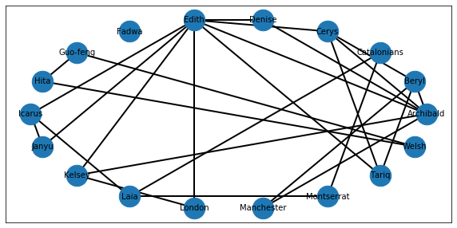
Undirected, unweighted, circular layout
Notes:
Just as an alternative, I have also included an unweighted, undirected circular layout network of a larger document set. Archie, Beryl, Tariq and Cerys are all still here, but there are more nodes and more links. You will need to work through the jupyter notebook to see the larger document set and the steps behind this network visualisation.

Slide 30
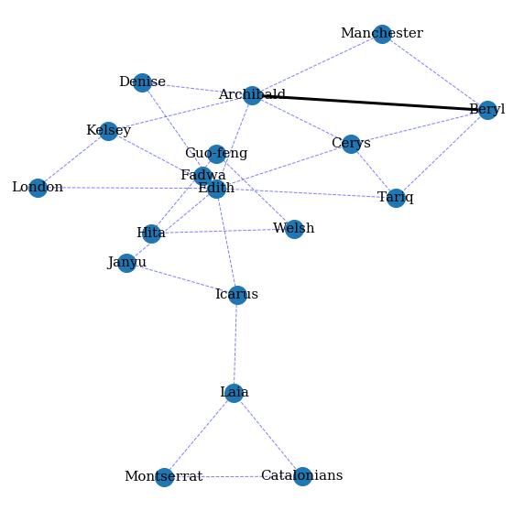
Weighted, undirected, spring layout
Notes:
Likewise, here is a different view, this time still undirected but with edge weights created by summing up the number of different times that an edge was drawn between the different nodes. There are lots of options for how network graphs can be laid out, how the nodes and edges can be drawn, etc.

Slide 31
Links to code, python packages and resources
https://github.com/UKDataServiceOpen/text-mining/tree/master/code
nltk (Natural Language Toolkit) https://www.nltk.org/book/ch01.html
nltk.corpus http://www.nltk.org/howto/corpus.html
spaCy https://nlpforhackers.io/complete-guide-to-spacy/
Semantic vectors package https://github.com/semanticvectors/semanticvectors/wiki
Geometry and Meaning, by Dominic Widdows https://web.stanford.edu/group/cslipublications/cslipublications/site/1575864487.shtml
Networkx python package https://networkx.github.io/documentation/stable/reference/index.html

Slide 32


Dr. J. Kasmire
julia.kasmire@manchester.ac.uk
@JKasmireComplex
UKDS
@UKDataService
UKDataService

